Slide 1
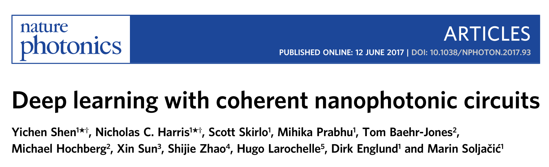
Journal Club - Loris Marini
18th August 2017

Slide 2
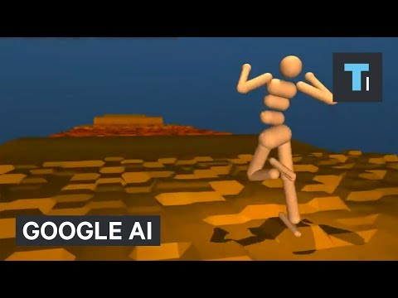
Google Deepmind
Towards General Purpose AI

Slide 3
Wy Machine Learning?
We do not want to write a piece of code for every single task.
Rather we want to teach a machine the “principle’ and let it solve problems for us.

Slide 4
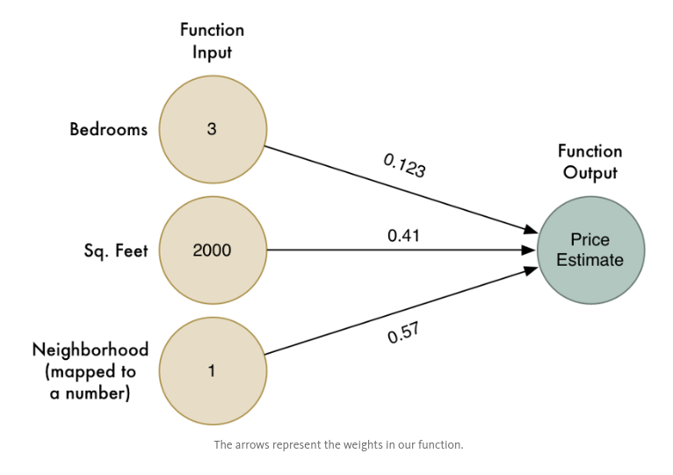
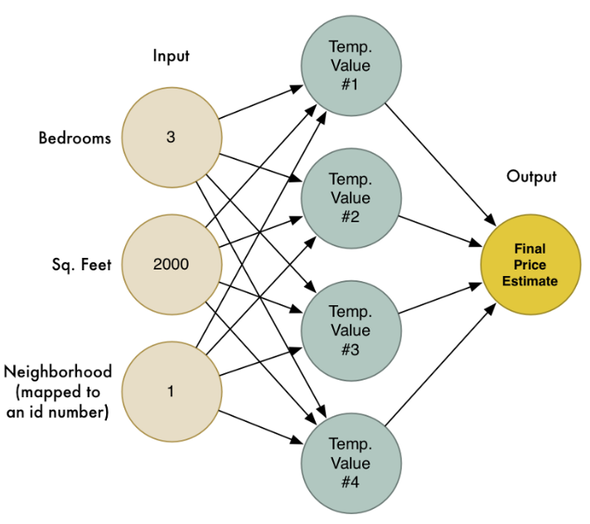
Neural Networks: Intro
Useful Architectures to model nonlinear systems
Source: http://bit.ly/237saIB

Slide 5
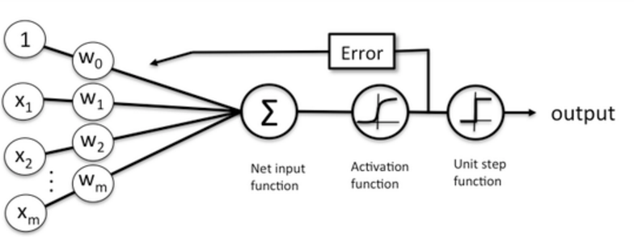
Training a Neural Network
Find the right sets of weights by feeding back the error.
Data
Weights
How to calculate the error ?
Testing
Training
Dataset
http://bit.ly/2c7wjZ9
Notes:
A Neural Network without Activation function would simply be a Linear regression Model, which has limited power and does not perform well most of the times. A net with a single layer does not allow for nonlinear combinations of inputs no matter what activation function you use.
Note that activation functions should be differentiable. We need it to be this way so as to perform back-propagation optimization strategy while propagating backwards in the network to compute error gradients (with respect to weights).

Slide 6
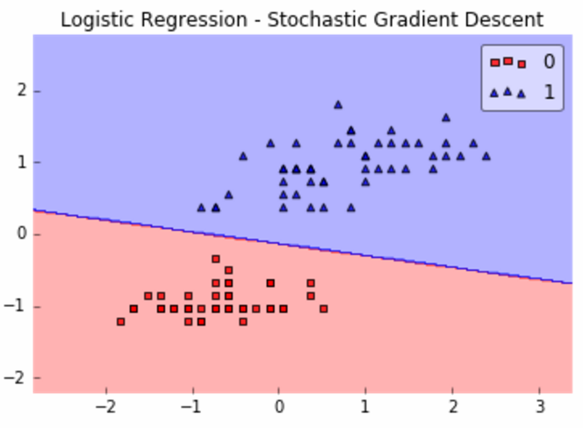
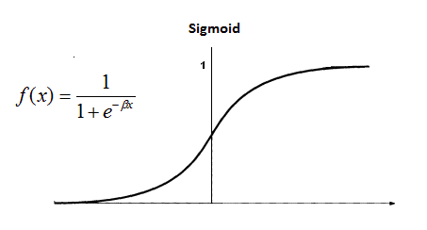
For a nonlinear behavior a single layer is not enough
http://bit.ly/2c7wjZ9
Notes:
A Neural Network without Activation function would simply be a Linear regression Model, which has limited power and does not perform well most of the times. A net with a single layer does not allow for nonlinear combinations of inputs no matter what activation function you use.
Note that activation functions should be differentiable. We need it to be this way so as to perform back-propagation optimization strategy while propagating backwards in the network to compute error gradients (with respect to weights).

Slide 7
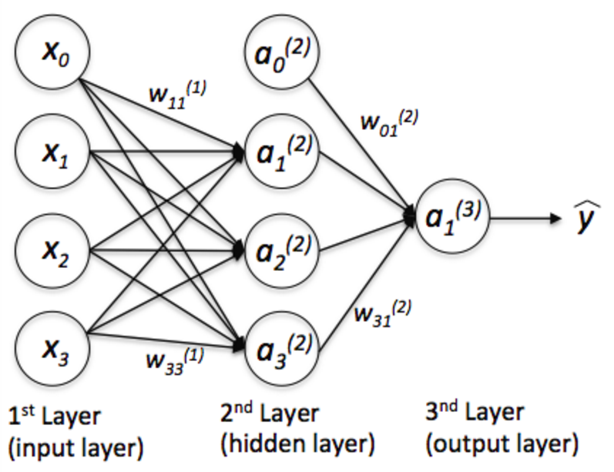
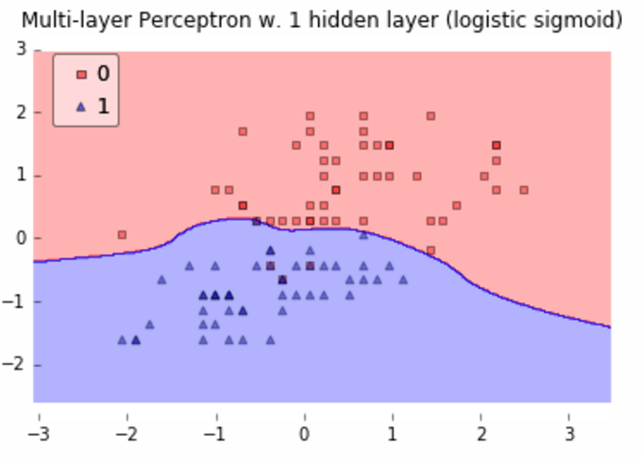
Multilayer + Nonlinear activation function = Nonlinear Response
http://bit.ly/2c7wjZ9

Slide 8
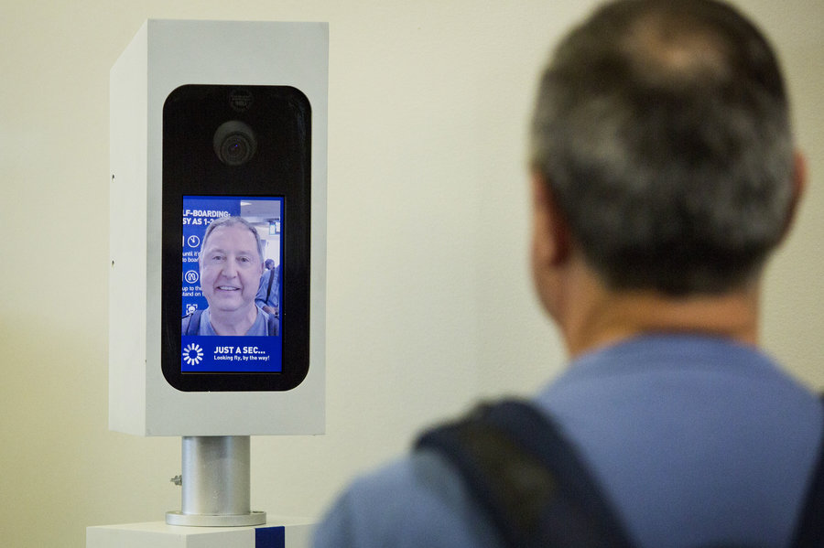
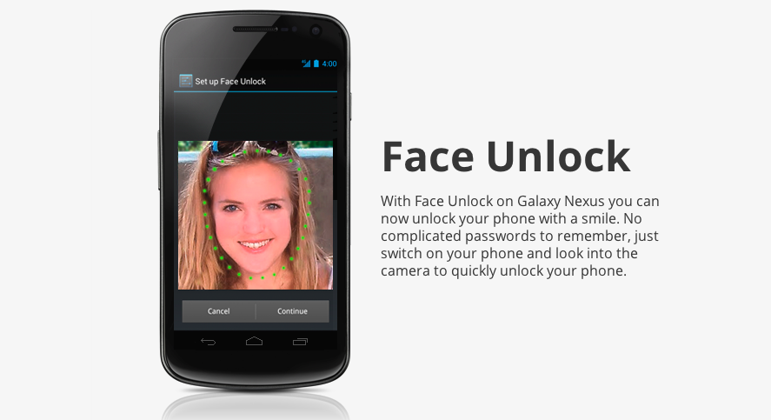
If you do it right…
Airport safety
Cryptography

Slide 9
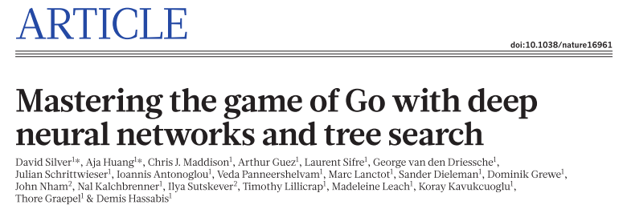
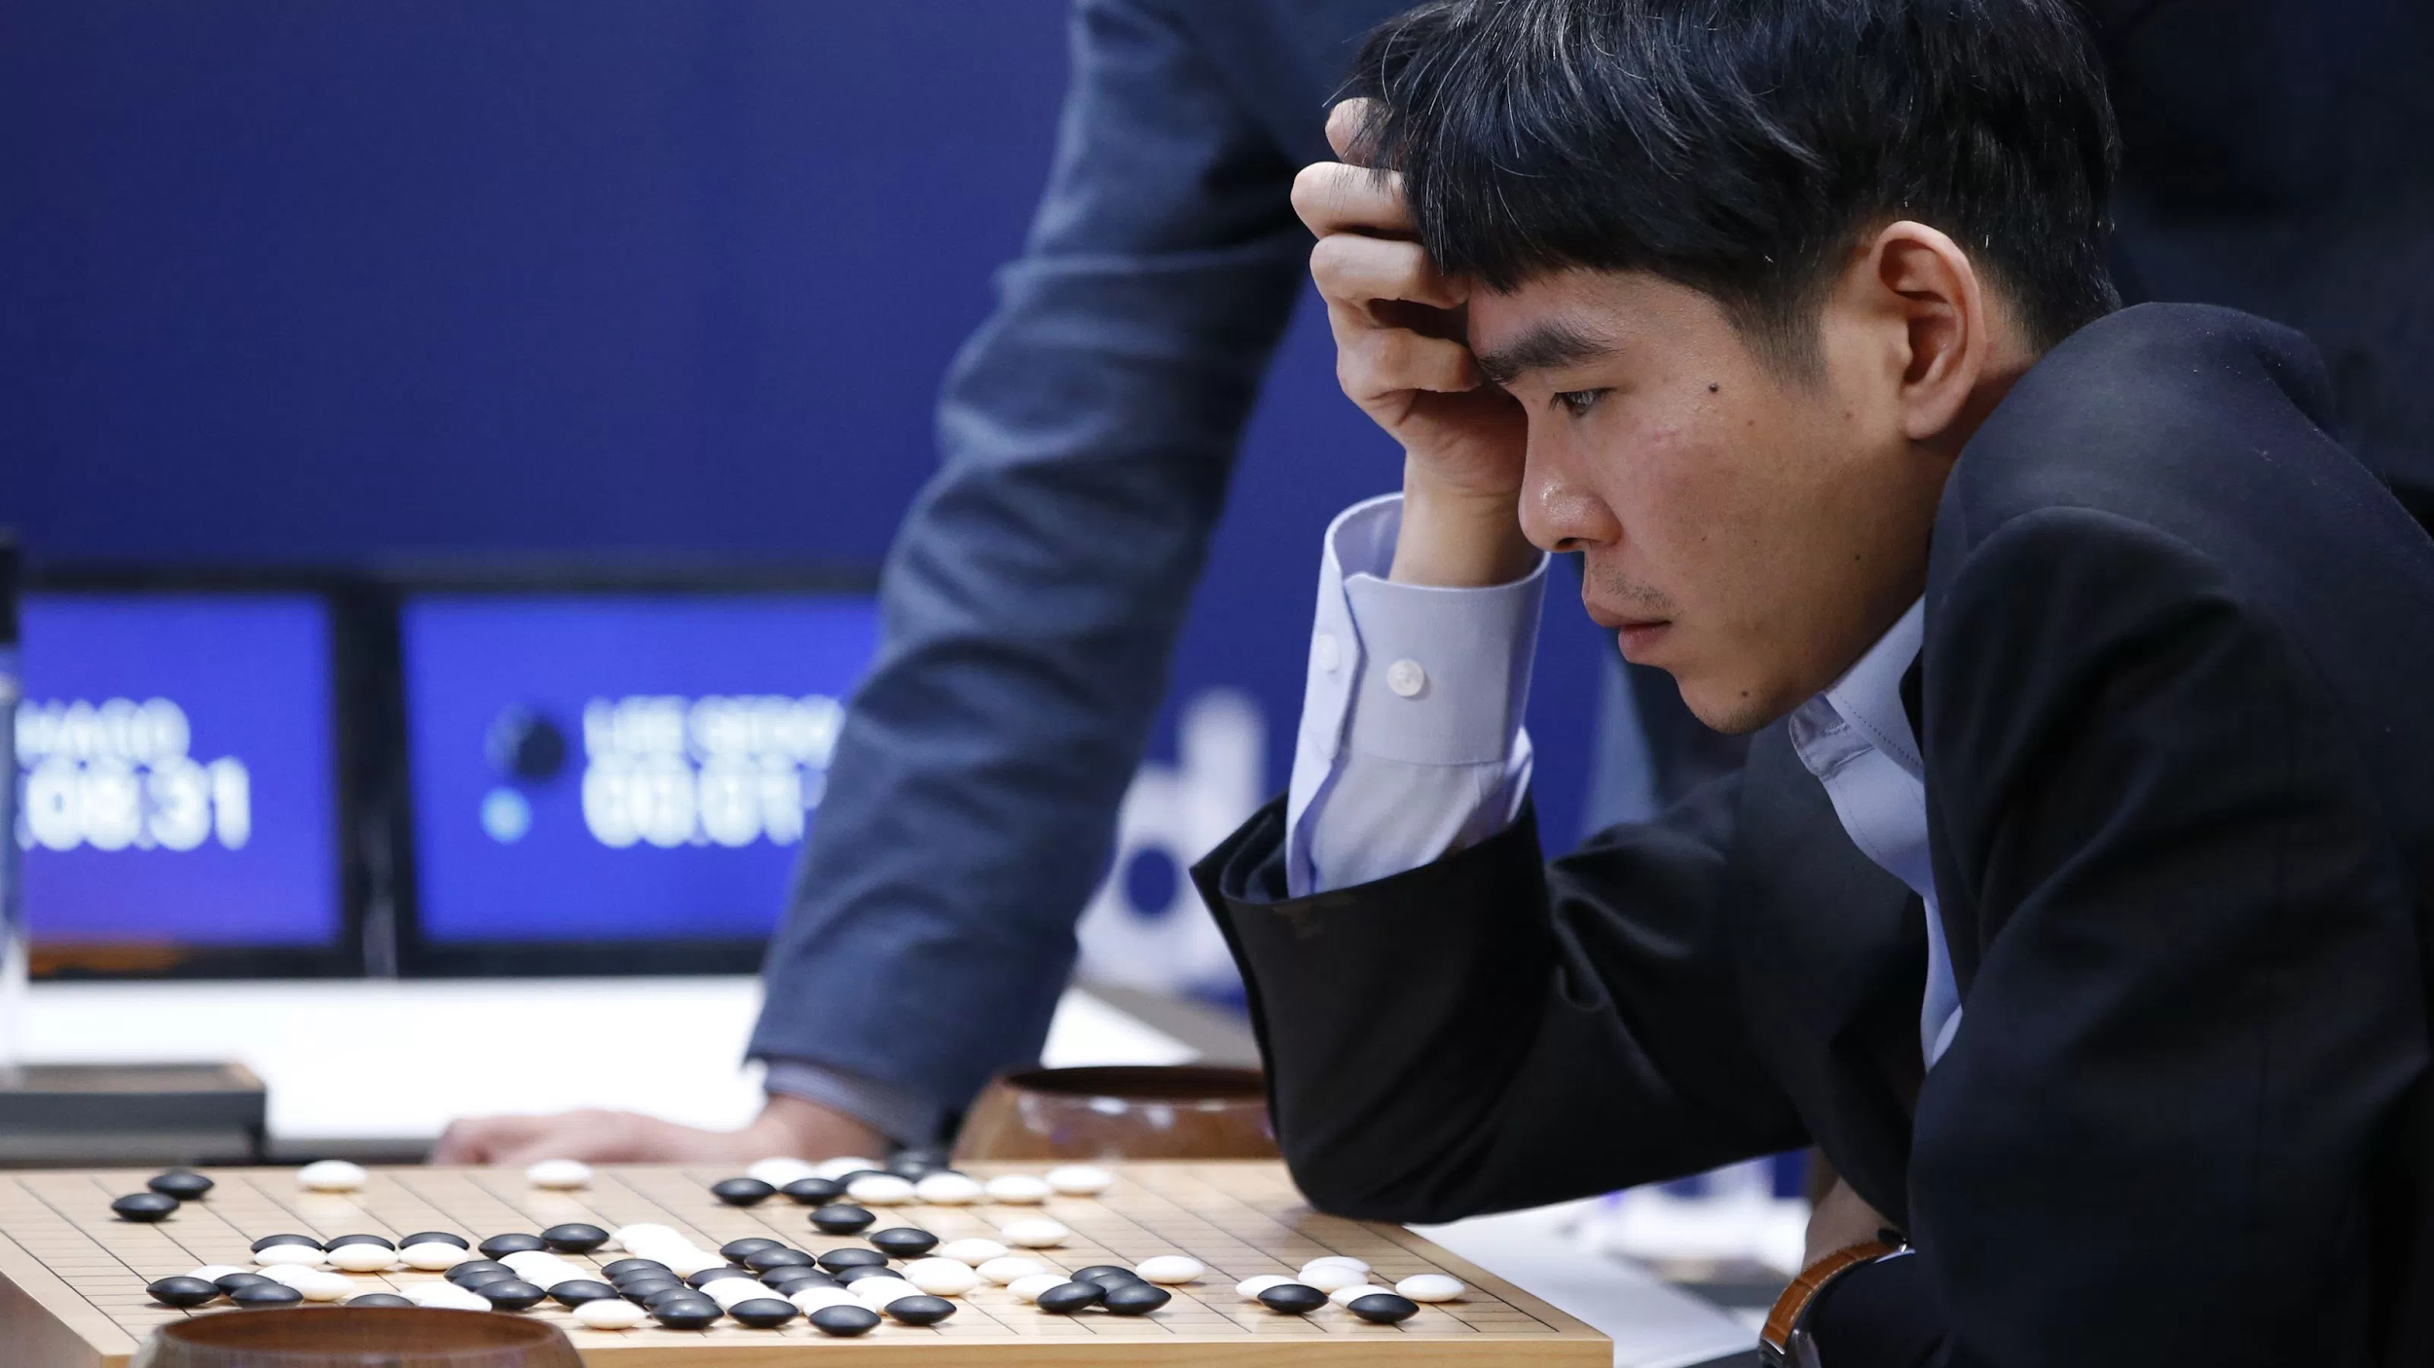
If you do it right…
Google AlphaGo

Slide 10
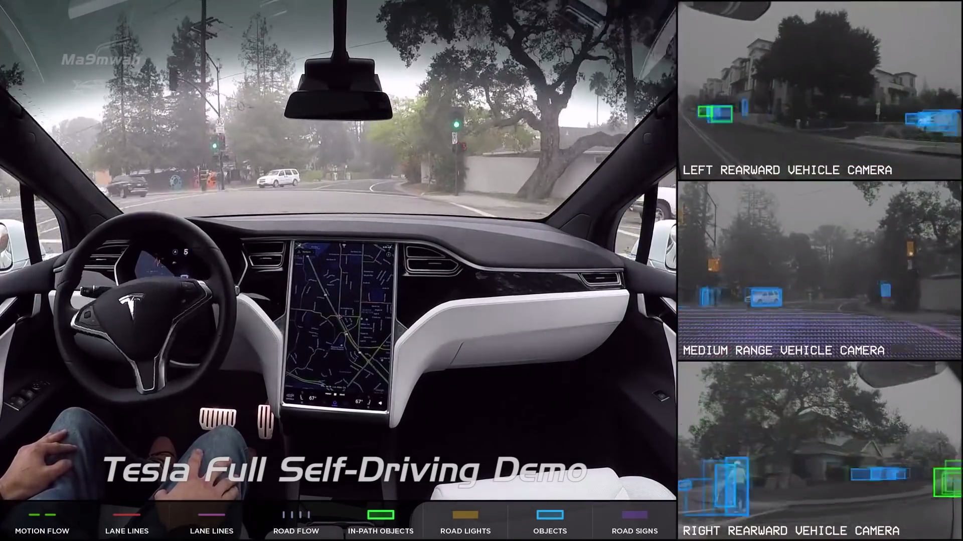
If you do it right…
Autonomous Vehicles
http://bit.ly/2i9z3fI

Slide 11
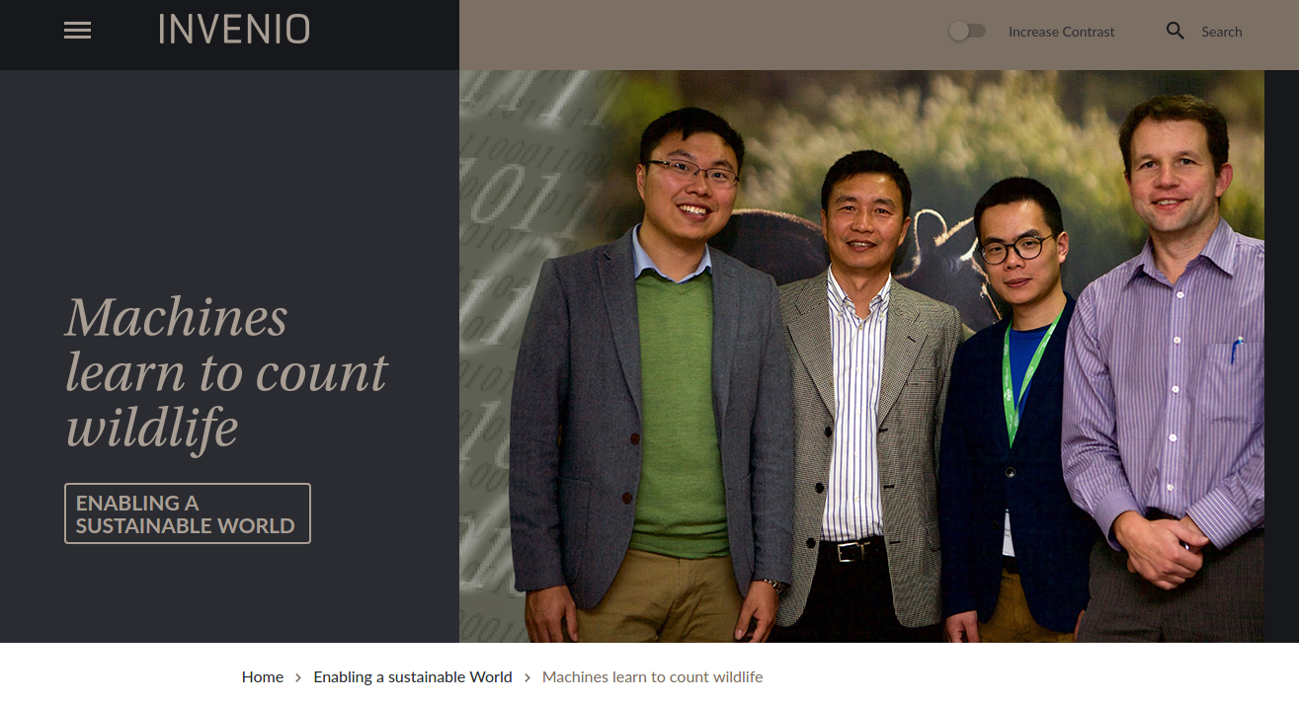
If you do it right…
Tracking and logging wildlife

Slide 12
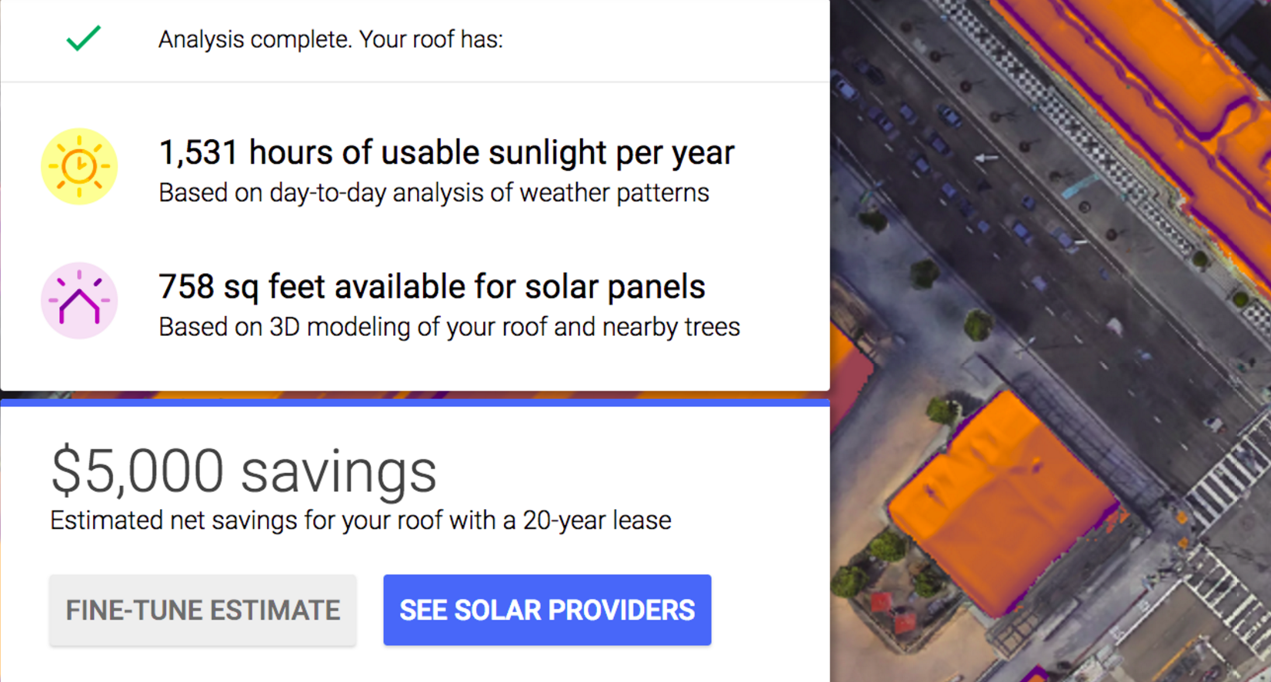
If you do it right…
Predicting real estate for solar
http://bit.ly/1Pw78gb

Slide 13
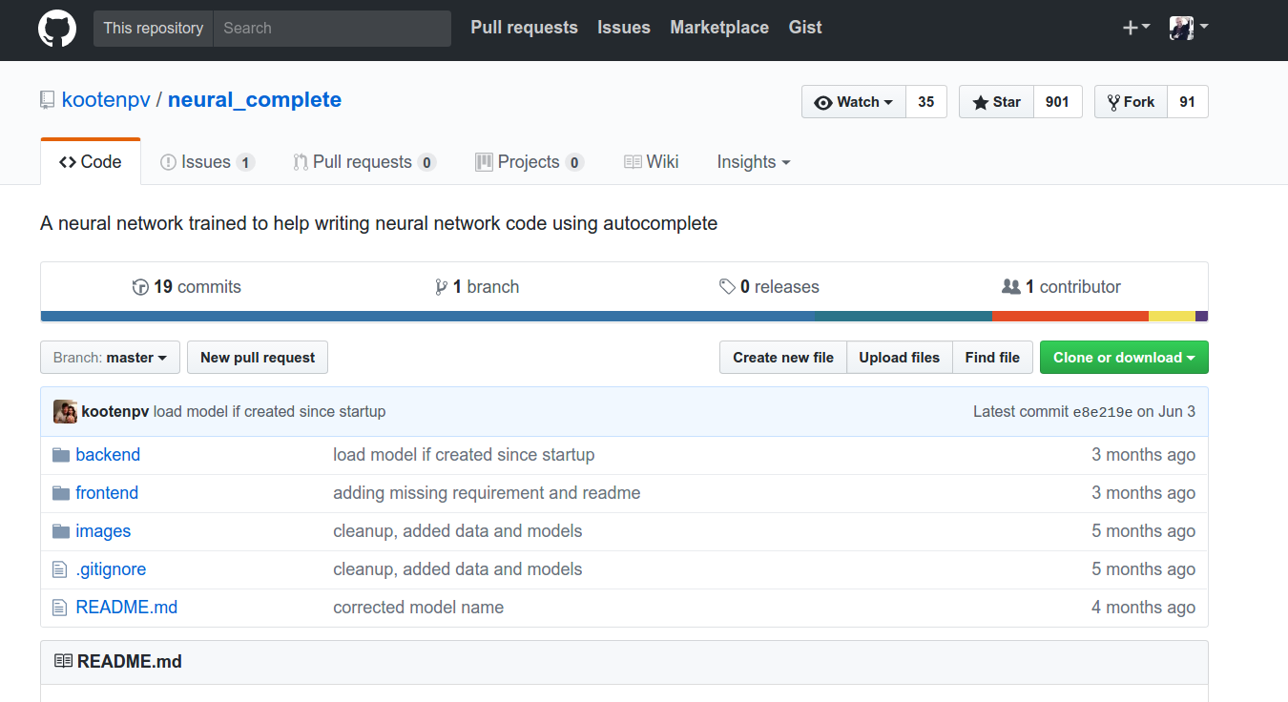
If you do it right…
Using neural nets to create other neural nets
http://bit.ly/2oB89hQ

Slide 14
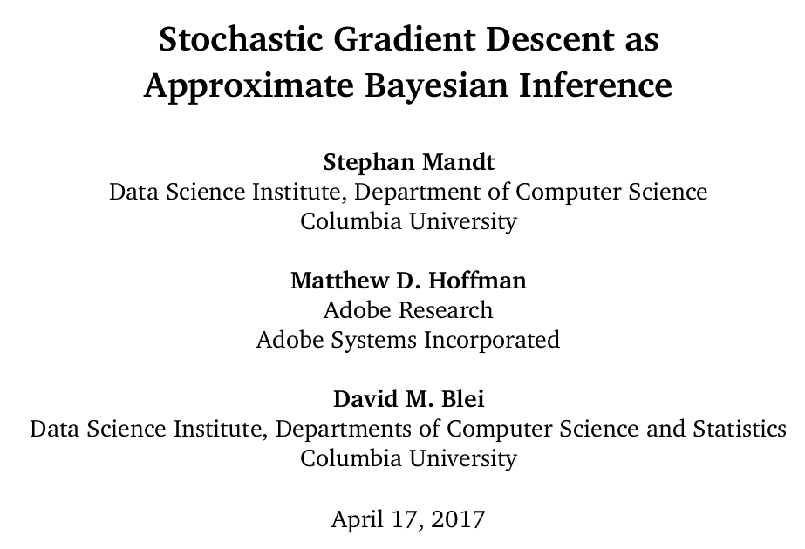
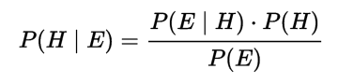
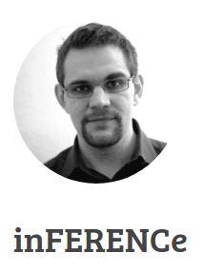
Why Deep Learning Works?
Thanks to the optimization algorithms used.
The most common optimization algorithm used
in machine learning
http://bit.ly/2qnAA0j

Slide 15
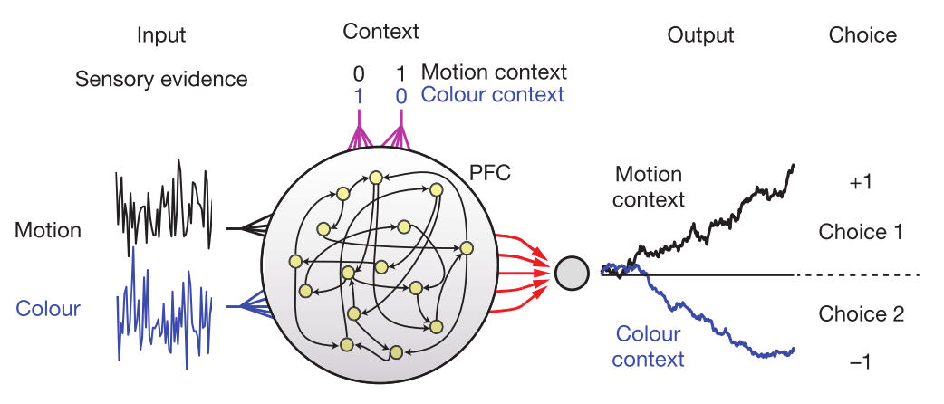
Recurrent Dynamic Systems
Can reproduce dynamics of neuron populations in the prefrontal cortex.
Mante, V, et. al. (2013). https://doi.org/10.1038/nature12742
Notes:
Key Points:
A study prefrontal cortex activity (PFC) in macaque monkeys trained to flexibly select and integrate noisy sensory inputs towards a choice.
To understand how this works you need to look at the dynamics of populations of neurons..

Slide 16
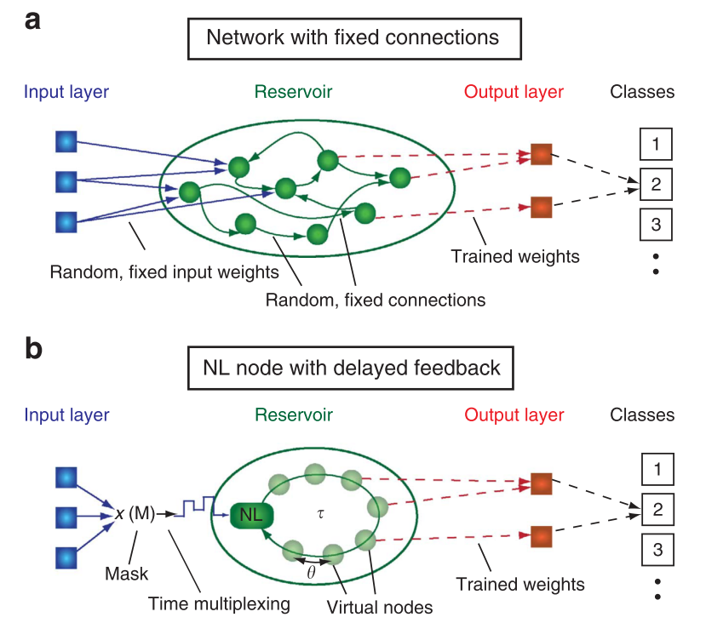
Recurrent Dynamic Systems
What happens if you allow information transfer backwards?
Recurrent networks manifest transient dynamics.
The transient dynamical states are fundamental for computation.
Adapted From: Vandoorne, K. et. al. (2014).
Nature Communications, 5, 3541. Read not recommended.
Notes:
Structure: The reservoirs usually consist of 100 - 1000 of randomly connected dynamical nodes receiving the information to be processed via input signals.
What makes it different from standard neural networks: when excited by an external stimulus (i.e. the information to be processed), the reservoir might exhibit complex transient dynamics which is the essential part of this type of information processing.
Nature Paper: Here they do supervised learning for classification, with time multiplexing thus reducing the usually required large number of elements to a single nonlinear node with delayed feedback. The arrows that go back inside the Reservoir introduce nonlinearity (memory). To efficiently solve its tasks, a reservoir should: use of a large number of reservoir nodes that are connected to each other (several hundreds / thousands of non linear reservoir nodes to obtain good performance) Have fading memory (short term) Results of RC computations should be robust against noise.
If information flow goes in one direction only you are dealing with FNN (Forward Neural Networks). You can represent them with acyclic graphs. If information flow can go in all directions you have a Recurrent Neural Network (RNN) which can be represented with a cyclic graph. -- Source: Schmidhuber, J. (2015). Deep learning in neural networks : An overview. Neural Networks, 61, 85–117.

Slide 17
Optical
Artificial Neural Networks

Slide 18
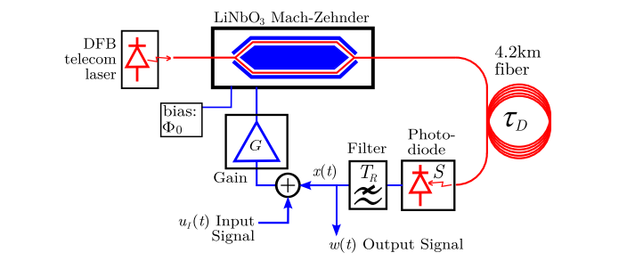
Optical Reservoir Computing
Optoelectronic version with time multiplexing.
Larger, L. et. al. (2012). Optics Express, 20(3), 3241–9.

Slide 19
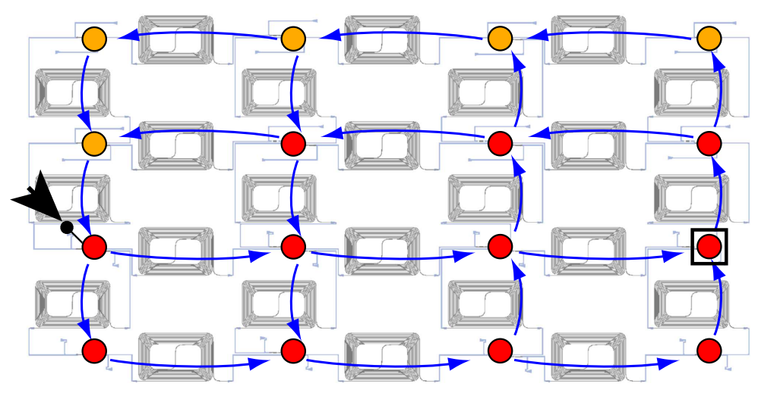
Optical Reservoir Computing
All optical with ring resonators.
Mesaritakis, C. et. al. J. Opt. Soc. Am. B 30, 3048–3055 (2013)
Reading not recommended.
Notes:
OVERALL IMPRESSIONS: Fails completely to explain how the nonlinearity resulting from the act of “measuring the power” compares to a nonlinearity intended as memory in the system…

Slide 20
The paper….

Slide 21
“There is a need for a better architecture for computing that the Von Neumann.”
“ We propose a new architecture for fully optical neural network that is energy efficient and faster than conventional electronic systems.”
“Once a neural network is trained, the architecture can be passive, and computation on the optical signals will be performed without additional energy input.”

Slide 22
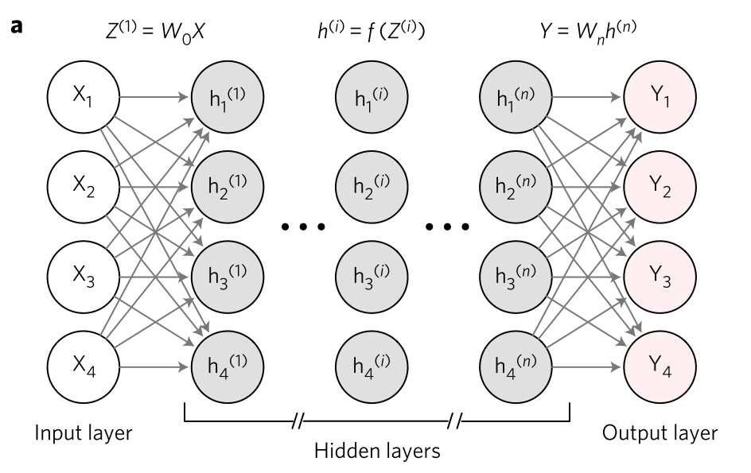
Architecture: a beautiful drawing...

Slide 23
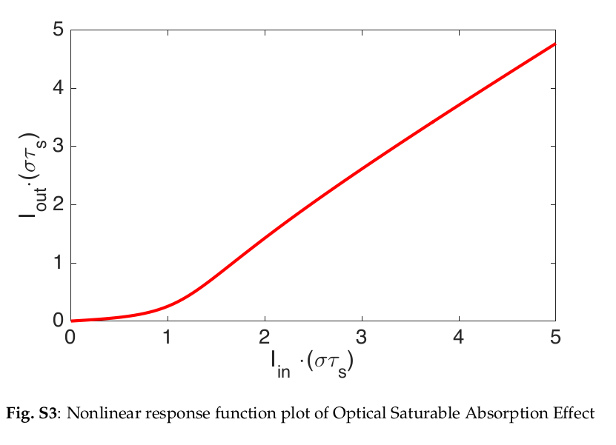
Nonlinear Activation Function
Saturable Absorbers based on Graphene
Notes:
τs is the radiative lifetime of the absorber material.

Slide 24
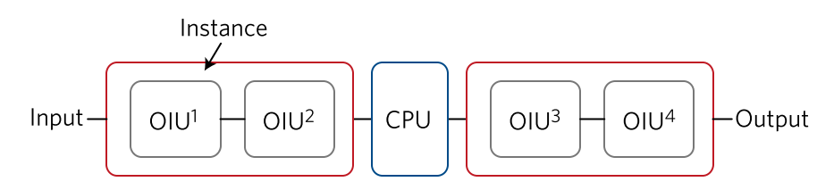

Architecture: In reality
4 neurons - 2 layers
Layer 1
Layer 2
Matrix Multiplication
Matrix Multiplication
Nonlinear Activation Functions
The central part of a Neural Network.
Notes:
τs is the radiative lifetime of the absorber material.

Slide 25
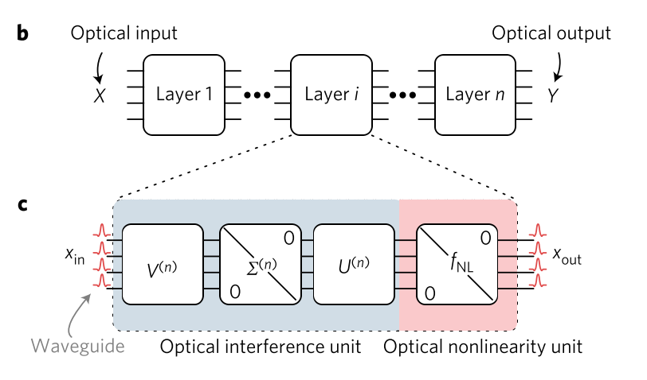
How a single layer looks like
Linear Matrix
Multiplication
Nonlinear Activation Function
Notes:
Red Rectangle = classical preprocessing of the input (say an image) into optical pulses that can enter the photonic circuit (Encoding)

Slide 26
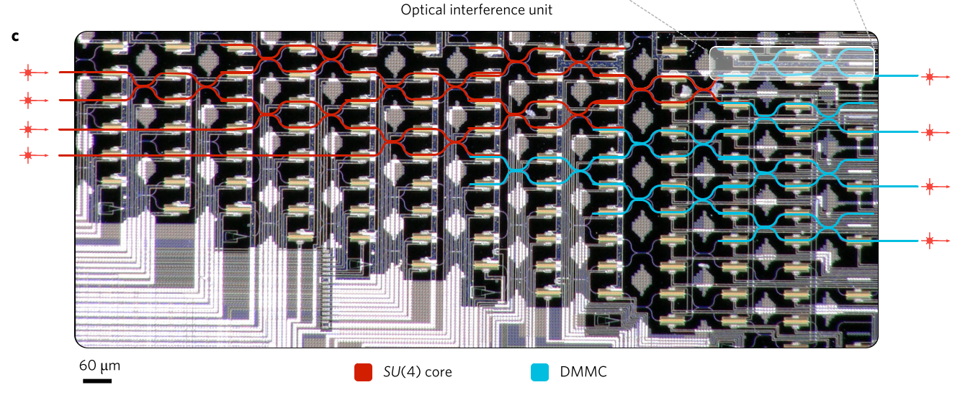
Notes:
The window with these particular coefficients was proposed by Richard W. Hamming. The window is optimized to minimize the maximum (nearest) side lobe, giving it a height of about one-fifth that of the Hann window.
360 sounds of vowels (data points), 50% for training, 50% for testing.

Slide 27
Experiment:
Dataset: 90 people recorded the sound of letter ‘A’, ‘B’, ‘C’, ‘D’.
1. Multiply sound by Hamming Function
2. Fourier Transfor
3. Find power spectral density
4. Use a normal CPU to train the network
5. Input lasers inside photonic chip
6. Get off-chip to introduce some nonlinearity
7. Go back on chip with new lasers
8. Propagate through network
9. Detect result
Electron
Photon
Electron
Photon
Electron
Notes:
The window with these particular coefficients was proposed by Richard W. Hamming. The window is optimized to minimize the maximum (nearest) side lobe, giving it a height of about one-fifth that of the Hann window.
360 sounds of vowels (data points), 50% for training, 50% for testing.

Slide 28
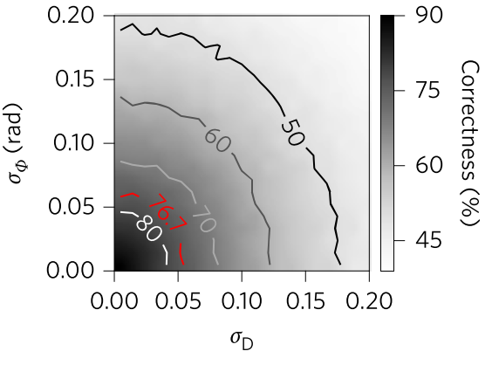
Results
76.7 % vs 91.7 % accuracy for a 64 bit CPU
Notes:
Correct identification ratio in percent for the vowel recognition problem with phase-encoding (σΦ) and photodetection error (σD).

Slide 29
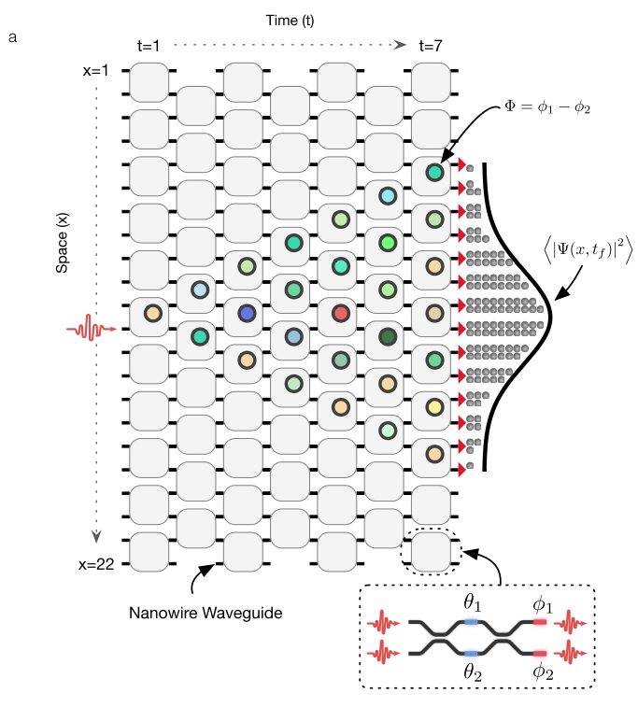
Claim on the architecture #1
“Integrated photonics provides a scalable solution to large, phase-stable optical transformations”
Harris, N. C. et al. Preprint at http://arXiv.org/abs/1507.03406 (2015).

Slide 30
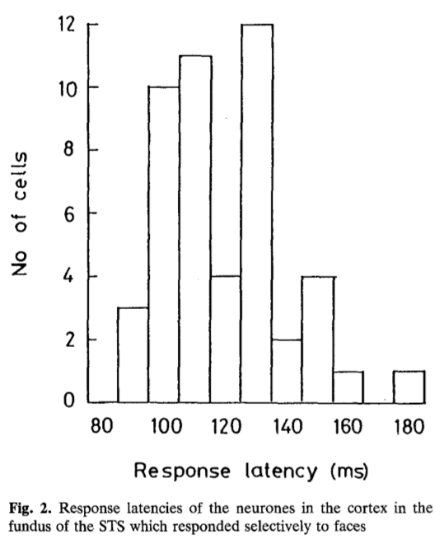
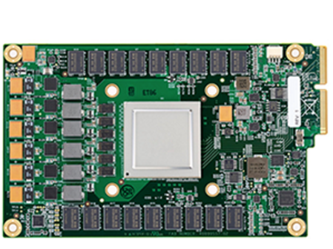
Claim on the architecture #2
“... would enable forward propagation 100 + times faster than electronic / optoelectronic systems”
Google Tensor Flow Unit
Built on a 28nm process, runs at 700MHz
D. I. Perrett et. al. Exp. Brain Res. 47, 329–342 (1982).
Notes:
Speed doesn’t make the learning better.
What makes the learning better is the encoding you use.
2) For example, we know that a single cortical area in macaque monkey is capable of analyzing and classifying visual patterns in just 30 ms, in spite of the fact that these neurons’ firing rates are usually below 100 Hz—i.e., less than three spikes in 30 ms.

Slide 31
Claim on the architecture #3
“… significantly lower latency than electronic digital computers. Useful for real time applications (autonomous driving or missile tracking).”
This is a physical truth. Does it really matter ?

Slide 32
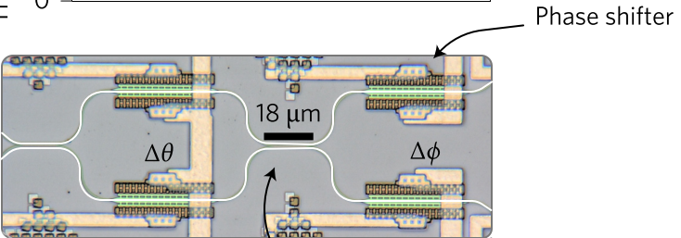
Claim on the architecture #4
“...after training, forward propagation computing is performed optically on a passive system.”
10mW per phase shifter (40 mW per neuron).
In a 10^6 neurons (assuming you can ever make a photonic chip with 10^6 interconnects) would be 40 kW.
This is 10^6 times less efficient than IBM’s TrueNorth: < 100 mW of power for 10^6 neurons.
You still need the nonlinear response for the net to work well… pump your saturable absorber!
Notes:
“However, in future implementations, the phases could be set with nonvolatile phase-change materials 45, which would require no power to maintain. With this change, the total power consumption would be limited only by the physical size, the spectral bandwidth of dispersive components (THz) and the photodetection rate (100 GHz).”
Each Mach-Zehnder interferometer is comprised of four phase shifters: thermo-optic phase shift (θ) between two 50% evanescent directional couplers, followed by another phase shifter (ϕ). The splitting ratio was controlled with an internal phase shifter and the differential output phase was controlled with the external phase shifter.

Slide 33
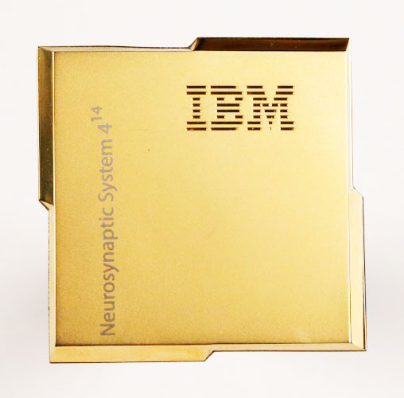
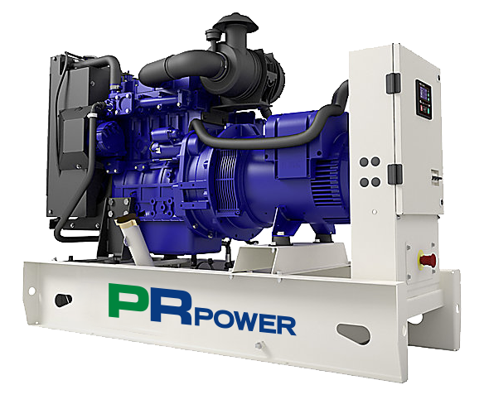
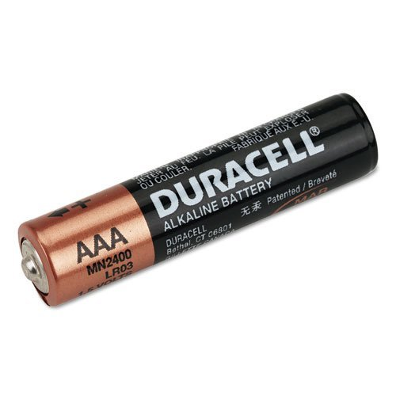
Claim on the architecture #4 (Continued)
vs
vs
Notes:
250 million synapses in IBM TrueNorth (100 mW). To compete, their photonic chip should have at least 500 million interferometers and 2 billion phase shifters and it would need 40 kW to be powered up. Even if you did not care about the petrol generator, good luck wiring 2 billion of thermal phase shifters up.

Slide 34
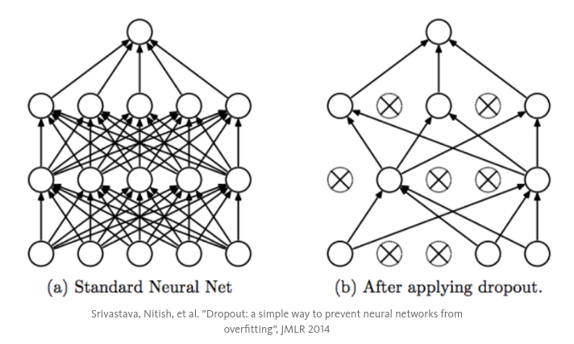

Claim on the architecture #5
“ ..in optical architecture power consumption is nearly proportional to the number of neurons (instead of quadratic, as in electronics).”
Spiking Networks: Not ON all the time.
Drop-out in neural Networks: http://bit.ly/2wdnXvB
Notes:
In deep learning an all-to-all network leads to overfitting (i.e. the net does not generalize). Often half the neurons are trained in a probabilistic manner (it’s called dropout)
This is an old architecture implemented in the optical domain. Because it relies on interference, light must be there all the time. In neuromorphic circuits instead you can keep the net off for a long time.

Slide 35
Claim on the architecture #6
“...time multiplexing = bigger effective networks with less neurons.”
This is true for both optical and electronic nets.
It does not mean necessarily that the energy efficiency increases.
learning not as good (connectivity between virtual nodes is limited to local couplings including few nearest neighbors See: Larger, L. et. al. (2012). Optics Express, 20(3), 3241–9.

Slide 36
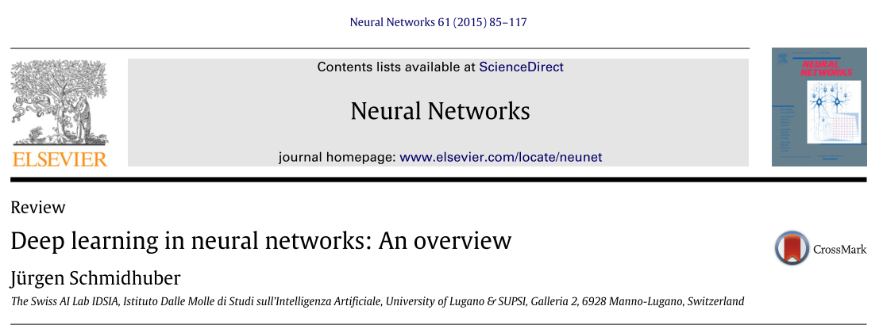
A good reference from the paper!

Slide 37
Hardware for Artificial Neural Networks

Slide 38
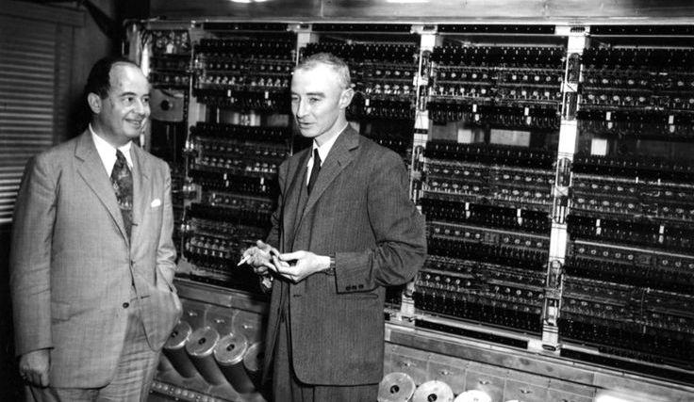
65 Years from the first Turing-complete Machine...
Notes:
Left: John Von Neumann
Right: J. Robert Oppenheimer
June 1952

Slide 39
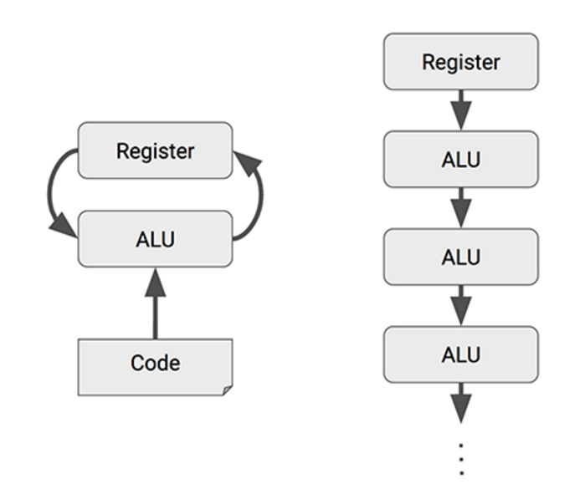
The Problem with the Von Neumann Architecture
Google TPU (Tensor Flow Unit) new architecture
Conventional CPUs
Systolic Array - MUX (Google Designed) CPUs
Notes:
The design is called systolic because the data flows through the chip in waves, reminiscent of the way that the heart pumps blood.

Slide 40
Neuromorphic chips inspired by our brain
Neurons are not always ON!
Notes:
“Neuromorphic hardware, which is today’s most efficient platform for running neural networks”. Source - http://bit.ly/2fqZw7v
Spiking is a neural encoding strategy for information processing, that is distributed and asynchronous. It processes information using both space and time and exhibit the efficiency of analog processing with the robustness of digital communication.
Digital in amplitude
Analog in Time

Slide 41

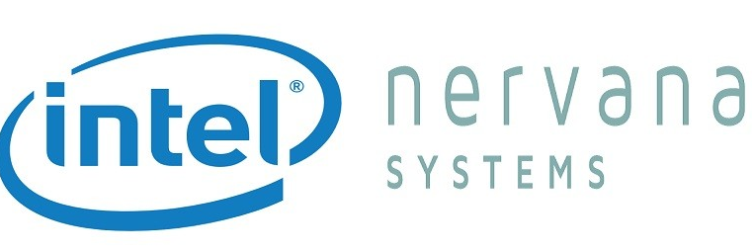
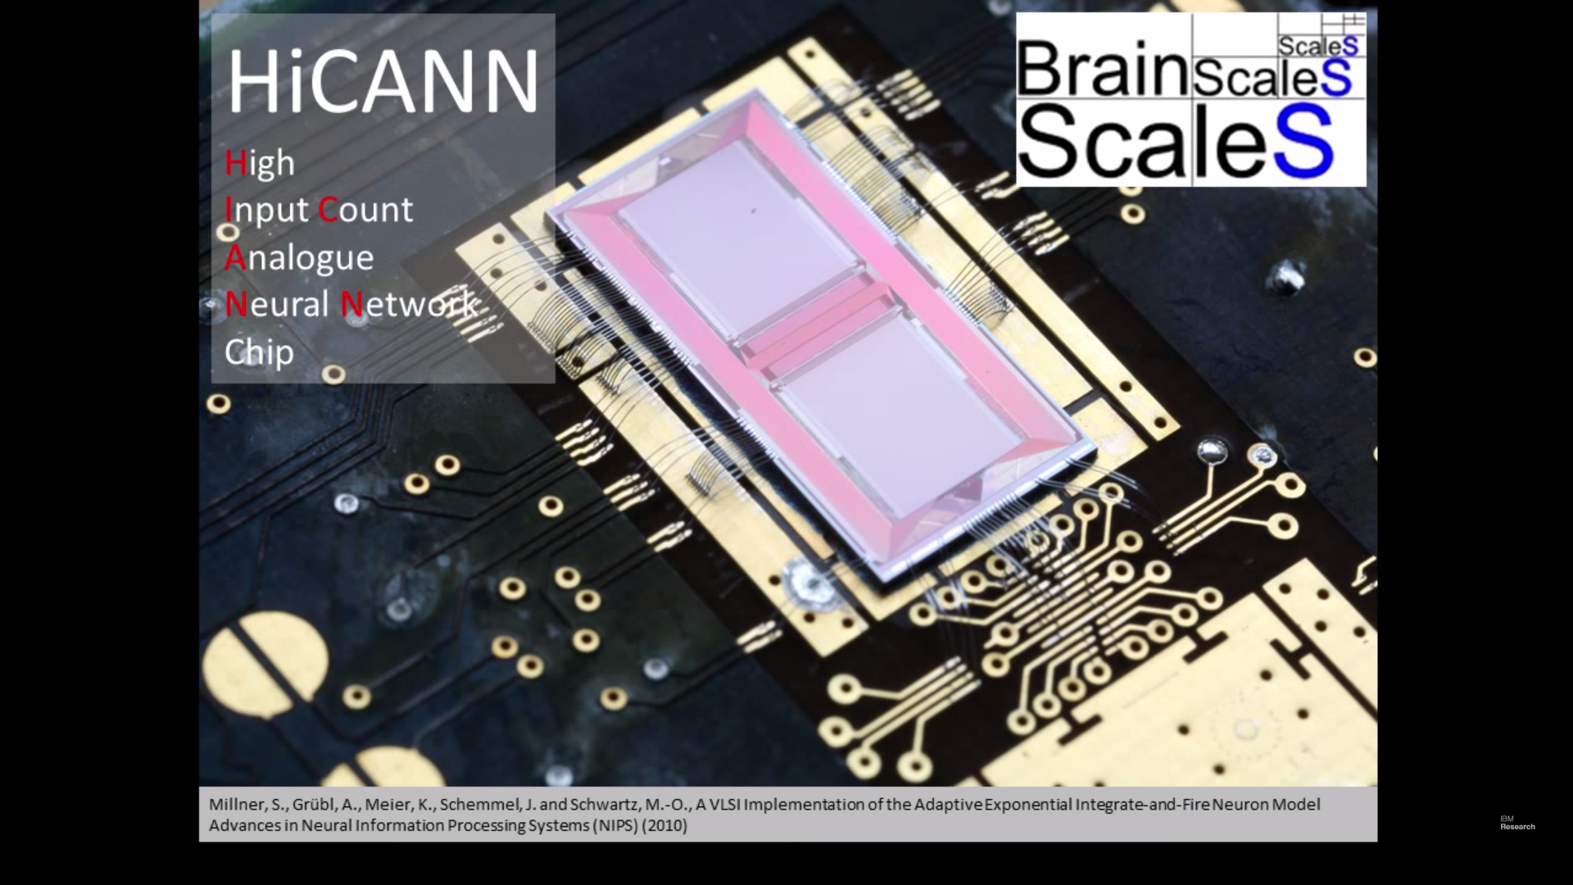
Spike Processing
It’s all in the architecture.
Google TPU
Intel
IBM’s TrueNorth
Human Brain Project
HICANN
Notes:
http://stanford.io/2w8h0vB

Slide 42
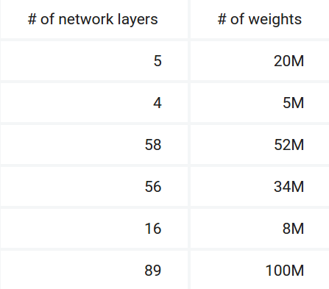
Architecture - Google TPU (Tensor Flow Unit)
Machine Learning accelerators in Google Data centers since 2015
Source: http://bit.ly/2se11Xu
Source: http://bit.ly/2se11Xu
Notes:
Google First TPU
Weights = Neurons
Even though CPUs run at clock speeds in the gigahertz range, it can still take a long time to execute large matrix operations via a sequence of scalar operations. One effective and well-known way to improve the performance of such large matrix operations is through vector processing, Usually, ASIC development takes several years. In the case of the TPU, however, we designed, verified, built and deployed the processor to our data centers in just 15 months. (Source: http://bit.ly/2p1puxQ). Built on a 28nm process, runs at 700MHz and consumes 40W when running. Used to make predictions very quickly, are behind every search query for Google Image Search, Google Photos, Google Translate, Google DeepMind.
In July 2016, we surveyed six representative neural network applications across Google’s production services and summed up the total number of weights in each neural network architecture.

Slide 43
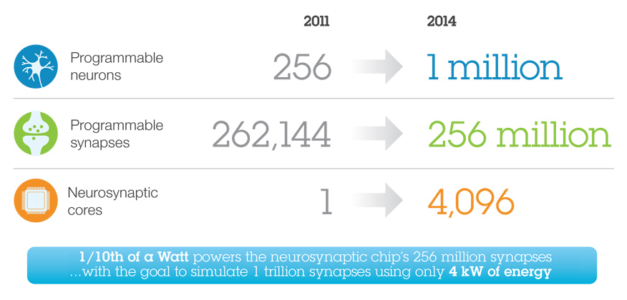
Neurosynaptic Chips - IBM’s TrueNorth
5.4 billion transistors, no clock.
Source: https://ibm.co/1r7vKPq
Notes:
IBM TrueNorth
Fabricated in Samsung’s 28nm process, with 5.4 billion transistors, TrueNorth is IBM’s largest chip to date in transistor count. If one were to measure activities of 1 million neurons in TrueNorth, one would see something akin to a night cityscape with blinking lights. The inputs to and outputs of this computer are spikes. Functionally, it transforms a spatio-temporal stream of input spikes into a spatio-temporal stream of output spikes.
While simulating complex recurrent neural networks, TrueNorth consumes < 100mW of power and has a power density of 20mW / cm2.
Unlike the prevailing von Neumann architecture—but like the brain—TrueNorth has a parallel, distributed, modular, scalable, fault-tolerant, flexible architecture that integrates computation, communication, and memory and has no clock. The architecture can solve a wide class of problems from vision, audition, and multi-sensory fusion, and has the potential to revolutionize the computer industry by integrating brain-like capability into devices where computation is constrained by power and speed.

Slide 44
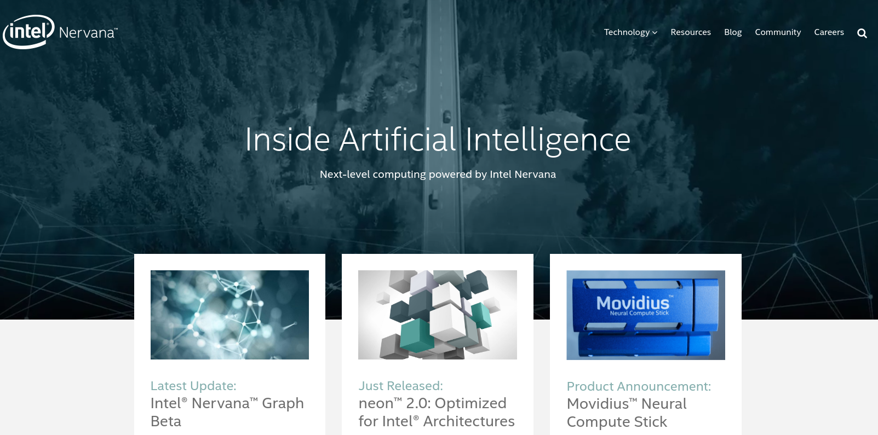
Architecture - Google TPU (Tensor Flow Unit)
Machine Learning accelerators in Google Data centers since 2015
Intel Fact Sheet: http://intel.ly/2usZTSy
Notes:
Design Principles:
Programmable vector-processors,
Software-controlled, multi-core, multi-ported memory subsystem
high sustainable on-chip data and instruction bandwidth
twelve processors, 2 RISC processors and high-performance video hardware accelerators.

Slide 45
Extracted from a Talk by Prof Karlheinz Meier,Univ. Heidelberg (DE): http://bit.ly/2x25jE5

Slide 46
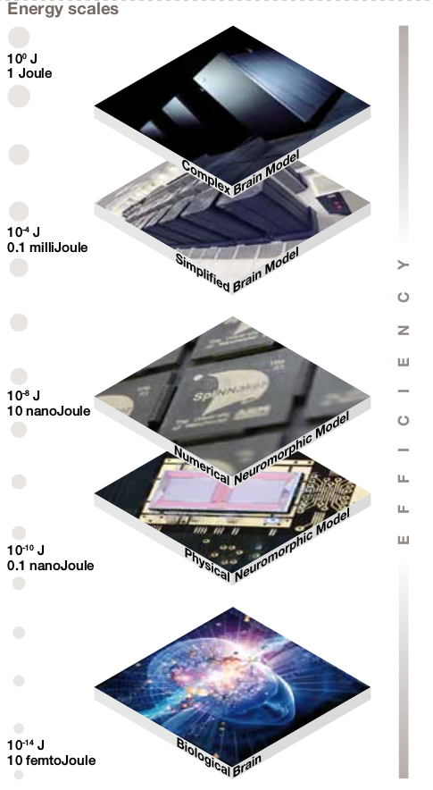
Energy Efficiency HICANN
J/synaptic transition (overheads included)
Source: http://bit.ly/2uZI77R
Notes:
Energy used for synaptic transition (Including all overheads!!)
A complex Brain Model on a Supercomputer takes 1 J per synaptic transition
A simplified Brain Model on a Supercomputer takes 100 uJ per synaptic transition
The Brain uses a femtojoule

Slide 47
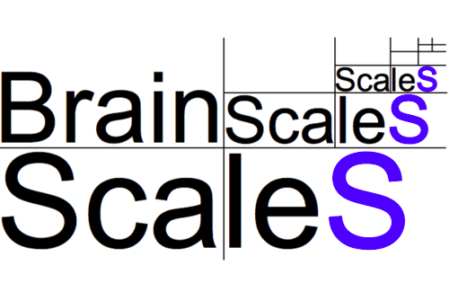
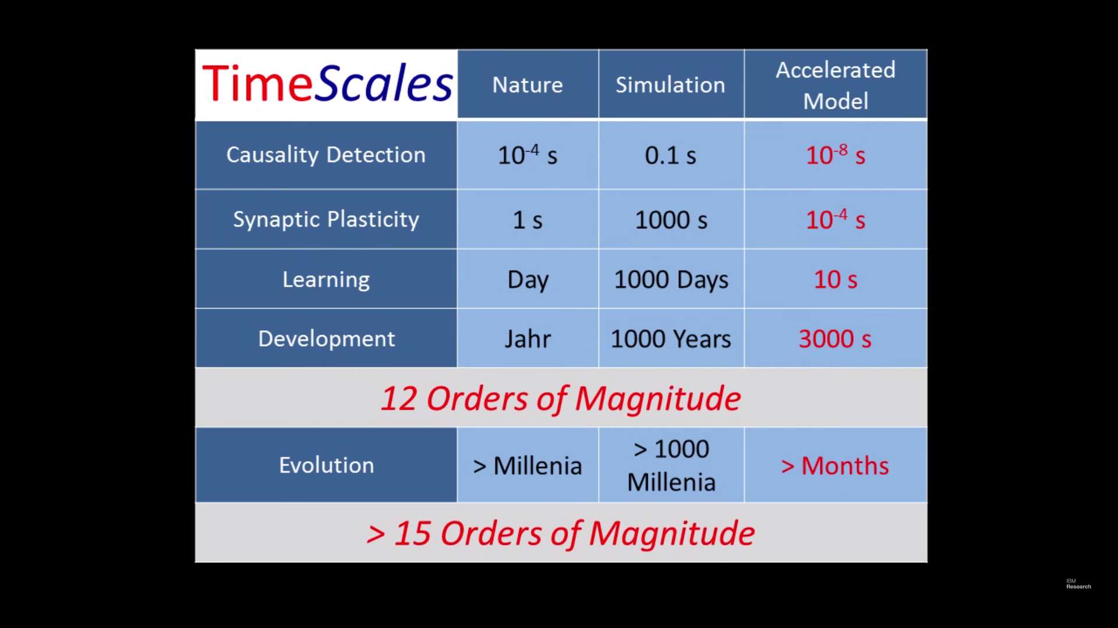
Human Brain Project (European 2020)
HICANN, University of Heidelberg, Germany
Extracted from a Talk by Prof Karlheinz Meier,Univ. Heidelberg (DE): http://bit.ly/2x25jE5
Notes:
http://bit.ly/2fFKoDa
http://bit.ly/2wKV1sO

Slide 48
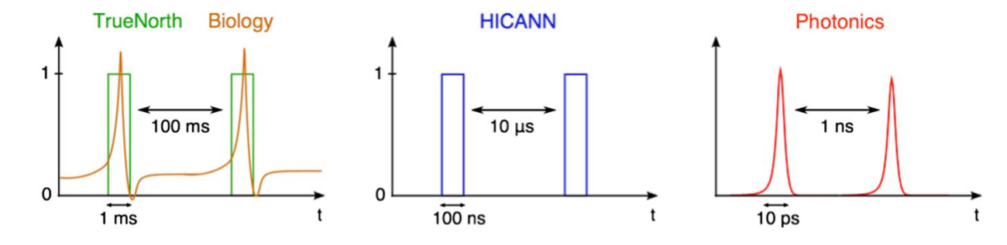
Neuromorphic chips and spike processing
Time scales: biological neurons vs electronic spiking neurons vs photonic neurons.
Prucnal, P. R. et. al. (2016). Advances in Optics and Photonics, 8(2), 228.

Slide 49
A solution looking for a problem?

Slide 50
Extras

Slide 51

Bayes Theorem Visualized

Slide 52


Stochastic Gradient Descent
Notes:
How Gradient Descend works: http://www.kdnuggets.com/2017/04/simple-understand-gradient-descent-algorithm.html

Slide 53

Matrix Multiplication with linear optics
Singular Value Decomposition
Unitary Matrix
(Beam splitters and phase shifters)
Optical attenuation
Optical amplification
“Matrix multiplication with unitary matrices implemented in the manner above consumes, in principle, no power.”

Slide 54

A playground for Neural Networks
Source: http://bit.ly/2w8RJ4F

Slide 55

Types of Machine Learning

Slide 56

Neural Nets, Deep Learning and Machine Learning
Source: http://bit.ly/2wrkGGz
Notes:
Neural Networks, Deep Learning and ML (The Big Picture)
Machine learning (ML), a subset of AI, make machines learn from experience, from examples of the real world: the more the data, the more it learns.
Artificial Neural Networks (ANN) is only one approach to ML, others (not ANN) include decision trees, support vector machines, etc. Deep learning is an ANN with many levels of abstraction.
Source: http://www.kdnuggets.com/2017/07/ai-deep-learning-explained-simply.html

Slide 57

Libraries for Deep Learning
Source: http://bit.ly/2ro1t9O

Slide 58

Human Brain Project: Learning
Source: http://bit.ly/2w853XJ

Slide 59

7 examples of machine learning (witch code)

